Slide 1
SNEAK PEEK:
2024 Accounting Client Satisfaction Benchmark Report
October 30, 2024

Slide 2
Agenda
1
Introduction
The State of CX (Client Experience) for Acct Firms
5 Key Lessons From the 2024 Study
2
3

Slide 3
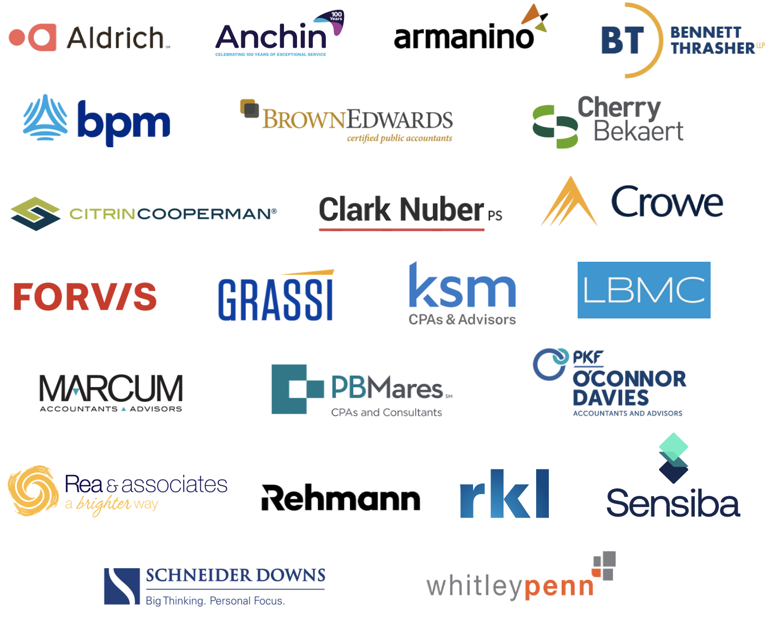
24 of the Top 100 accounting firms work with ClearlyRated

Slide 4
ClearlyRated is the CX platform for accounting firms
89% of customers rate us a 9 or 10
96% say we help them differentiate
97% report a positive ROI
Power CX for 350+ professional service firms
>$80B in annual revenue protected

Slide 5
Thank you to our U.S. research sponsor!

Slide 6
Net Promoter Score®
"Net Promoter, Net Promoter System, Net Promoter Score, NPS and the NPS-related emoticons are registered trademarks of Bain & Company, Inc., Fred Reichheld and Satmetrix Systems, Inc."

Slide 7
About the Research
Total of 497 responses corporate decision-makers involved with their accounting firm choices or the day-to-day engagement with their firm.
United States (n=157)
Canada (n=116)
United Kingdom (n=113)
Australia (n=111)
Study fielded between October 23rd and October 27th 2024
Sneak Peek available now, with more detailed reporting available in Q1 2025.

Slide 8
The State of CX (Client Experience)
Accounting client NPS dropped slightly in 2024 after multiple year rise
38
29
PANDEMIC
IMPROVEMENT
44
37
SOURCE: ClearlyRated

Slide 9
The State of CX (Client Experience)
Many firms deliver service at world class levels, yet variance is increasing
SOURCE: ClearlyRated

Slide 10
The State of CX (Client Experience)
Client experience is high, but not improving over the past 3 years
SOURCE: ClearlyRated

Slide 11
The State of CX (Client Experience)
Clients of mid-sized accounting firms less satisfied than peers with national firms
Client of Small,
Local Firm
Client of Mid-Sized,
Regional Firm
Client of Large,
National Firm
Client of
Big 4 Firm
32
NPS
48
NPS
47
NPS
21
NPS
SOURCE: ClearlyRated

Slide 12
The State of CX (Client Experience)
Relationship leads are nearly 2x less likely to be detractors of their primary acct firm
49
NPS
23
NPS
SOURCE: ClearlyRated

Slide 13
The State of CX (Client Experience)
Perceived value and proactivity amongst least delivered attributes of service
Impact on NPS
+38 points
+34 points
+32 points
+25 points
+21 points
+28 points
SOURCE: ClearlyRated

Slide 14
The State of CX (Client Experience)
Unexpected cost over-runs have largest negative impact on client satisfaction
Impact on NPS
-24 points
-4 points
-7 points
-3 points
-6 points
+12 points
SOURCE: ClearlyRated

Slide 15
Lesson 1:
You are already doing work for your best sources of 2025 growth
A Little
(<11%)
Some
(11% - 50%)
Most
(51 - 99%)
All
(100%)
IMMEDIATE OPPORTUNITY
Earn the business
Identify the opportunity
Leverage proof of excellence
Promoters (9-10) are 4x more likely to expect a ‘significant’ increase in spend with their primary accounting firm in 2025
SOURCE: ClearlyRated

Slide 16
Lesson 2:
Economic uncertainty continues to weigh on accounting firm clients
54%
39%
rate the current state of the economy as ‘fair’ or ‘poor’
of clients believe the economy is getting worse, not better
SOURCE: ClearlyRated

Slide 17
Lesson 2:
Budgets are coming under fire, with focus on reducing internal costs and cash flow
SOURCE: ClearlyRated

Slide 18
Lesson 3:
Being top of mind with corporate finance leadership is essential
General B2B Buyers (Google Research)
Buyers of Acct Services (ClearlyRated Research)
Firms to Consider
Firms to Consider
ABC Accounting
Beyond Books
Above the Fold, Inc.
People Unlimited
Big Talent Co
Henderson Andrews, Inc.
92%
96%
81% Have a
‘Day One’ List
63% Have a
‘Day One’ List
Ultimately buy from a vendor on the ‘day one’ list
Ultimately partner with firm on the ‘day one’ list
1 or 2 firms
3 firms
4+ firms
NO ‘DAY ONE’ LIST
NUMBER OF FIRMS ON ’DAY ONE’ LIST
SOURCE: Google & ClearlyRated

Slide 19
Lesson 3:
Clients go beyond capabilities and expertise, wanting specific evidence of excellence
EVIDENCE
OF
EXCELLENCE
Online reputation
Industry-specific testimonials (10+)
Reputation of individual professionals on team
INDUSTRY EXPERT
+
EXPERTISE WITH COMPANIES LIKE ME
Industry-specific marketing / content
Roundtables / community building
Sales (BD) enablement
ACCOUNTING EXPERTISE
+
SPECIFIC CAPABILITIES NEEDED
Tenure of CPAs & professionals
Training / credentials
Wide breadth of services
SOURCE: ClearlyRated

Slide 20
Lesson 4:
Client onboarding is about expectation setting, understanding and communication
SOURCE: ClearlyRated

Slide 21
Lesson 5:
The impact of AI is unclear, but the expectations are high
GPT-3.5
NOV 2022
GPT-4.0
MAR 2023
SOURCE: https://www.visualcapitalist.com/how-smart-is-chatgpt/

Slide 22
Lesson 5:
The impact of AI is unclear, but the expectations are high
Organization’s current level of AI adoption for internal finance needs
Not
Considering
Exploration
Phase
Early
Adoption
Intermediate
Adoption
Advanced
Adoption
Accounting Firm Clients Expecting AI to ‘Somewhat’ or ‘Significantly’ Improve Each Attribute

Slide 23
Q&A
(the spot where I realize all the stuff I forgot to include)

